Slide 1
Searching in a Graph
CS 5010 Program Design Paradigms “Bootcamp”
Lesson 8.5
© Mitchell Wand, 2012-2016
This work is licensed under a Creative Commons Attribution-NonCommercial 4.0 International License.
TexPoint fonts used in EMF.
Read the TexPoint manual before you delete this box.: AAA

Slide 2
Introduction
Many problems in computer science involve directed graphs.
General recursion is an essential tool for computing on graphs.
In this lesson we will design a program for an important problem on graphs, using general recursion
The algorithm we will develop has many other applications.

Slide 3
Learning Objectives
At the end of this lesson you should be able to:
explain what a directed graph is, and what it means for one node to be reachable from another
explain what a closure problem is
explain the worklist algorithm
write similar programs for searching in graphs.

Slide 4
What's a graph?
You should be familiar with the notion of a graph from your previous courses.
A graph consists of some nodes and some edges.
We will be dealing with directed graphs, in which each edge has a direction. We will indicate the direction with an arrow.

Slide 5
A Graph
nodes: A, B, C, etc.
edges:
(A,B), (A,C),(A,D), etc.
A
B
C
D
E
F
G

Slide 6
successors of a node
The successors of a node are the nodes that it can get to by following one edge.
(successors A) = {B,C,D}
(successors D) = {C,F}
A
B
C
D
E
F
G

Slide 7
all-successors of a set of nodes
A
all-successors of a set of nodes are all the successors of any of the nodes in the set
(all-successors {}) = {}
(all-successors {A,D})
= {B,C,D,F}
B
C
D
E
F
G

Slide 8
Paths in a Graph
A path is a sequence of nodes that are connected by edges. Notice that the node A by itself is a path, since there are no edges to check. On the other hand, (A,A) is not a path, since there is no edge from A to itself.
A
B
C
D
E
F
paths:
(A,C,E)
(B,C,E,G)
(A,D,C,E)
(A)
non-paths:
(D, A)
(A,C,G)
(A,C,D,E)
(A,A)
G

Slide 9
Cycles
This graph has a cycle: a path from the node B to itself. Graphs without cycles are said to be acyclic.
For this lesson, our graphs are allowed to have cycles.
A
B
C
D
E
F
G

Slide 10
Reachability
One node is reachable from another if there is a path from the one node to the other.
A
B
C
D
Nodes reachable from D:
{B,C,D,E,F,G}
Not reachable:
{A}
E
F
G
D is reachable from itself by a path of length 0, but not by any other path

Slide 11
Another classic application of general recursion
reachables :
SetOfNode Graph -> SetOfNode
GIVEN: a set of nodes in a finite graph
RETURNS: the set of nodes that is reachable in the graph from the given set of nodes

Slide 12
Definition
A node t is reachable from a node s iff either
t = s
there is some node s' such that
s' is reachable from s, and
t is a successor of s'.

Slide 13
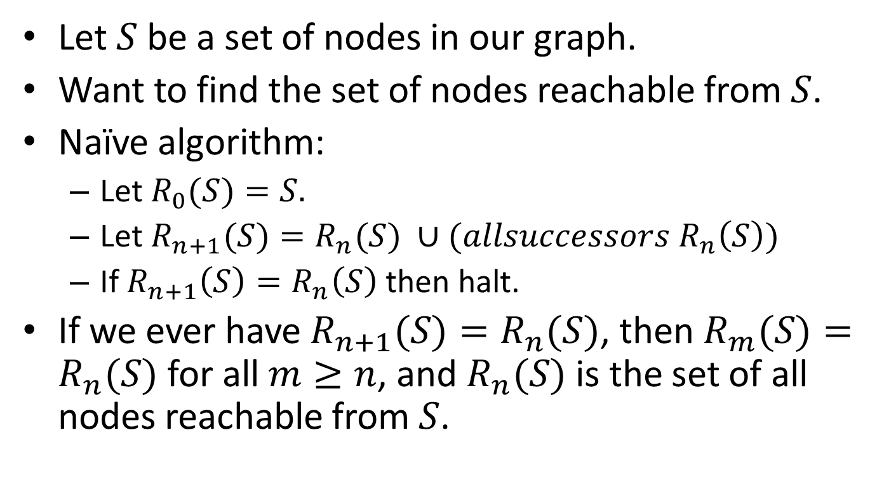
Enumerating the elements
Let $S$ be a set of nodes in our graph.
Want to find the set of nodes reachable from $S$.
Naïve algorithm:
Let $R_{0}(S)=S.$
Let $R_{n+1}(S)=R_{n}(S) ∪(allsuccessors R_{n}\left(S\right))$
If $R_{n+1}\left(S\right)=R_{n}\left(S\right)$ then halt.
If we ever have $R_{n+1}(S)=R_{n}(S)$, then $R_{m}(S)=R_{n}(S)$ for all $m≥n$, and $R_{n}(S)$ is the set of all nodes reachable from $S$.

Slide 14


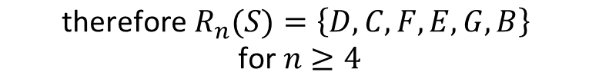




Example
A
A
A
A
B
C
D
B
C
D
B
C
D
B
C
D
E
F
E
F
E
F
E
F
G
G
G
G
$$S=\{D\}$$
$$R_{0}(S)=\{D\}$$
$$R_{1}(S)=\{D,C,F\}$$
$$R_{2}(S)=\{D,C,F,E,G\}$$
$$R_{3}(S)=\{D,C,F,E,G,B\}$$
This only works if the graph is finite. If the graph is infinite, this might run forever.
$$R_{4}(S)=\{D,C,F,E,G,B\}$$
$$\text{therefore} R_{n}(S)=\left\{D,C,F,E,G,B\right\}$$
$$\text{for} n≥4$$

Slide 15
Termination Reasoning
Halting measure: the number of white nodes
This is always a non-negative integer
Every step takes a white node and colors it green, so the number of white nodes decreases.
If there is no such node, the algorithm halts.
This assumes the graph is finite!! If the graph is infinite, the algorithm might not halt. The termination reasoning here wouldn't apply in an infinite graph, because the number of white nodes in an infinite graph is not an integer.

Slide 16
Closure problems
This is called a "closure problem": we want to find the smallest set R which contains our starting set S and which is closed under some operation
In this case, we want to find the smallest set that contains our starting set of nodes, and which is closed under all-successors.

Slide 17
Assumptions
We assume we've got data definitions for Node and Graph, and functions
node=? : Node Node -> Boolean
successors :
Node Graph -> SetOfNode
all-successors :
SetOfNode Graph -> SetOfNode
We also assume that our graph is finite.

Slide 18
Writing this as a function
;; reachables.v1 : SetOfNode Graph -> SetOfNode
;; GIVEN: A set of nodes in a finite graph
;; WHERE:
;; reached = the set of nodes reachable in
;; graph g in at most steps from a
;; set of nodes S, for some n and
;; some set of nodes S.
;; RETURNS: the set of nodes reachable from S.
;; STRATEGY: recur on reached + their immediate
;; successors
;; HALTING MEASURE: the number of nodes in g
;; NOT in reached.

Slide 19
Function Definition
(define (reachables.v1 reached g)
(local
((define candidates
(all-successors reached g)))
(cond
[(subset? candidates reached) reached]
[else (reachables.v1
(set-union candidates reached)
g)])))

Slide 20
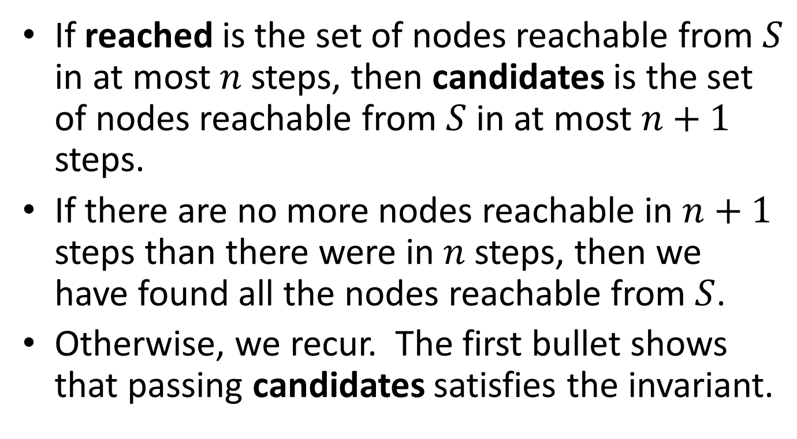
Correctness Reasoning
If reached is the set of nodes reachable from $S$ in at most $n$ steps, then candidates is the set of nodes reachable from $S$ in at most $n+1$ steps.
If there are no more nodes reachable in $n+1$ steps than there were in $n$ steps, then we have found all the nodes reachable from $S$.
Otherwise, we recur. The first bullet shows that passing candidates satisfies the invariant.

Slide 21
Termination Reasoning
At the recursive call, candidates contains at least one element that is not in reached (otherwise the subset? test would have returned true).
Hence the result of the set-union is at least one element bigger than reached. So the halting measure decreases.

Slide 22
Problem with this algorithm
We keep looking at the same nodes over and over again:
we always say (all-successors reached), but we've seen most of those nodes before.

Slide 23
A Better Idea: keep track of which nodes are newly found
S
only need to explore nodes in this region– all others are accounted for.

Slide 24
Do this with an extra argument and an invariant
S
recent = nodes reached in n steps but not in n-1 steps
reached = nodes reached in < n steps

Slide 25
Version with invariant
;; reachables1: SetOfNode SetOfNode Graph -> SetOfNode
;; GIVEN: two sets of nodes and a finite graph g
;; WHERE:
;; reached is the set of nodes reachable in graph g in fewer than n steps
;; from a set of nodes S, for some S and n
;; recent is the set of nodes reachable from S in n steps but
;; not in n-1 steps.
;; RETURNS: the set of nodes reachable from S in g.
(define (reachables1 reached recent g)
(local
((define next
(set-diff (all-successors recent g)
reached)))
(cond
[(empty? next) reached]
[else
(reachables1
(append next reached)
next
g)])))
Since next is disjoint
from reached, we can replace the set-union with append.

Slide 26
Example
A
A
A
A
B
C
D
B
C
D
B
C
D
B
C
D
E
F
E
F
E
F
E
F
G
G
G
G
unexplored
in recent
in reached

Slide 27
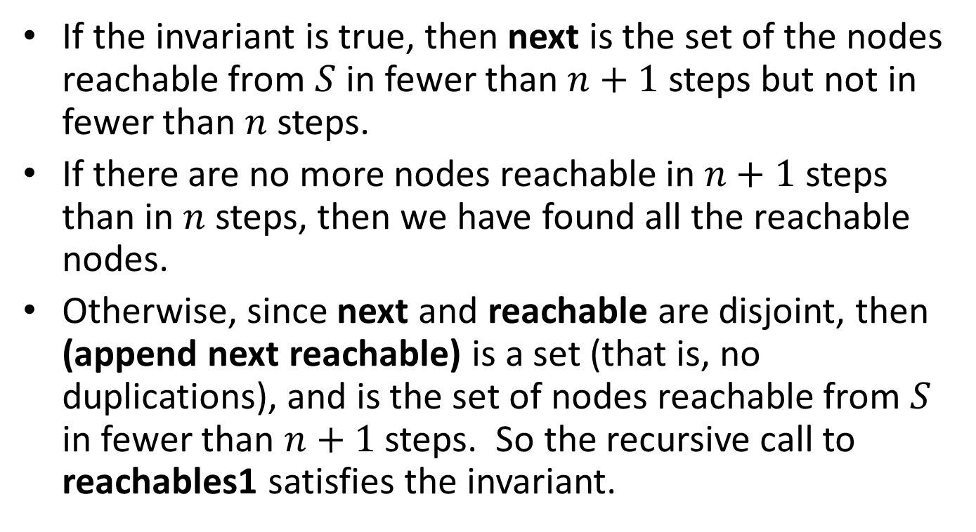
Correctness Reasoning
If the invariant is true, then next is the set of the nodes reachable from $S$ in fewer than $n+1$ steps but not in fewer than $n$ steps.
If there are no more nodes reachable in $n+1$steps than in $n$ steps, then we have found all the reachable nodes.
Otherwise, since next and reachable are disjoint, then (append next reachable) is a set (that is, no duplications), and is the set of nodes reachable from $S$ in fewer than $n+1$ steps. So the recursive call to reachables1 satisfies the invariant.

Slide 28
Termination Reasoning
At the recursive call, the new value of reachable is (append next reachable).
Since next is non-empty, (append next reachable) is longer than reachable.
So at the recursive call the the number of nodes not in the new value of reachable is smaller than the old value.

Slide 29
Initializing the invariant
;; reachables.v2 : SetOfNode Graph -> SetOfNode
;; GIVEN: A set of nodes in a finite graph
;; RETURNS: the set of nodes reachable from S.
;; STRATEGY: Call a more general function
(define (reachables.v2 nodes g)
(reachables1 empty nodes g))

Slide 30
Correctness Reasoning
There are no nodes reachable from nodes in fewer than 0 steps. The set of nodes reachable from nodes in at most 0 steps is just nodes. So the call to reachables1 satisfies reachable1's invariant.

Slide 31
Termination Reasoning
No termination reasoning is necessary here because this function simply calls reachables1, and we already know reachables1 terminates.

Slide 32
This is called the "worklist" algorithm
This is the simplest example of what's called a "worklist" algorithm.
It is used in many applications
in compiler analysis
in AI (theorem proving, etc.)

Slide 33
You could use this to define reachable?
;; reachable? : Graph Node Node -> Boolean
;; GIVEN: a graph and a source and a
;; target node in the graph
;; RETURNS: true iff there is a path in g
;; from src to tgt
;; STRATEGY: call more general function
(define (path? graph src tgt)
(member tgt (reachables (list src) graph)))

Slide 34
But for that, you don't need to build the whole set
(define (path? graph src tgt)
(local
((define (reachable-from? newest nodes)
;; RETURNS: true iff there is a path from src to tgt in graph
;; INVARIANT: newest is a subset of nodes
;; AND:
;; (there is a path from src to tgt in graph)
;; iff (there is a path from some node in newest to tgt)
;; STRATEGY: recur on successors of newest; halt when tgt is found.
;; HALTING MEASURE: the number of graph nodes _not_ in 'nodes'
(cond
[(member tgt newest) true]
[else (local
((define candidates (set-diff
(all-successors newest graph)
nodes)))
(cond
[(empty? candidates) false]
[else (reachable-from?
candidates
(append candidates nodes))]))])))
(reachable-from? (list src) (list src))))
Look carefully at this invariant.
Just watch for tgt to show up in newest
Why is the invariant true again at this call?
Can you check to see that the invariant is true at this call?

Slide 35
Another topic: changing the data representation
;; reachables: SetOfNode Graph -> SetOfNode
(define (reachables nodes graph)
(local
((define candidates (all-successors nodes graph)))
(cond
[(subset? candidates nodes) nodes]
[else (reachables
(set-union candidates nodes)
graph)])))
Notice that the only thing we do with graph is to pass it to all-successors.

Slide 36
So let’s pass in the graph’s all-successors function
;; reachables: SetOfNode (SetOfNode -> SetOfNode)
;; -> SetOfNode
(define (reachables nodes all-successors-fn)
(local
((define candidates (all-successors-fn nodes)))
(cond
[(subset? candidates nodes) nodes]
[else (reachables
(set-union candidates nodes)
all-successors-fn)])))

Slide 37
How do you build an all-successors-fn?
;; You could do it from a data structure:
;; Graph -> (SetOfNode -> SetOfNode)
(define (make-all-successors-fn g)
(lambda (nodes)
(all-successors nodes g)))

Slide 38
Or you could avoid building the data structure entirely
Just define a successors function from scratch, and then define all-successors using a HOF.
Good thing to do if your graph is very large– e.g. Rubik’s cube.

Slide 39
Example of an “implicit graph”
;; Int -> SetOfInt
;; GIVEN: an integer
;; RETURNS: the list of its successors in the implicit graph.
;; For this graph, this is always a set (no repetitions)
(define (successors1 n)
(if (<= n 0)
empty
(local
((define n1 (quotient n 3)))
(list n1 (+ n1 5)))))
A portion of this graph….
6
2
7
From Examples/08-5a-implicit-graphs.rkt
0
5
1

Slide 40
;; all-successors1 : SetOfInt -> SetOfInt
;; GIVEN: A set of nodes
;; RETURNS: the set of all their successors in our implicit graph
;; STRATEGY: Use HOFs map, then unionall.
(define (all-successors1 ns)
(unionall (map successors1 ns)))
Here’s a function you could pass to reachables.

Slide 41
Summary
We've applied General Recursion to an important problem: graph reachability
We considered the functions we needed to write on graphs in order to choose our representation(s).
We used list abstractions to make our program easier to write

Slide 42
Learning Objectives
You should now be able to:
explain what a directed graph is, and what it means for one node to be reachable from another
explain how the function for reachability works.
explain what a closure problem is
explain the worklist algorithm
write similar programs for searching in graphs.

Slide 43
Next Steps
Study 08-5-reachability.rkt and 08-5a-implicit-graphs.rkt in the Examples folder.
If you have questions about this lesson, ask them on the Discussion Board
Do Guided Practice 8.4

